Slide 1


Pacific Cascade MS PTSA
Membership Meeting
May 24, 2018

Slide 2

Agenda
Secretary’s Report
School Leadership Report
Officers’ and Directors’ Reports
Approval of Additional Enrichment Grants
Approval of 2018-2019 Budget
Preview of 2018-2019 PTSA Calendar
Parent Education: School Librarian Michael Fleming’s Summer Reading Recommendations

Slide 3
Secretary’s Report
Approval of minutes from March 15, 2018, membership meeting

Slide 4
School Leadership Report
Report from Principal Dana Bailey

Slide 5
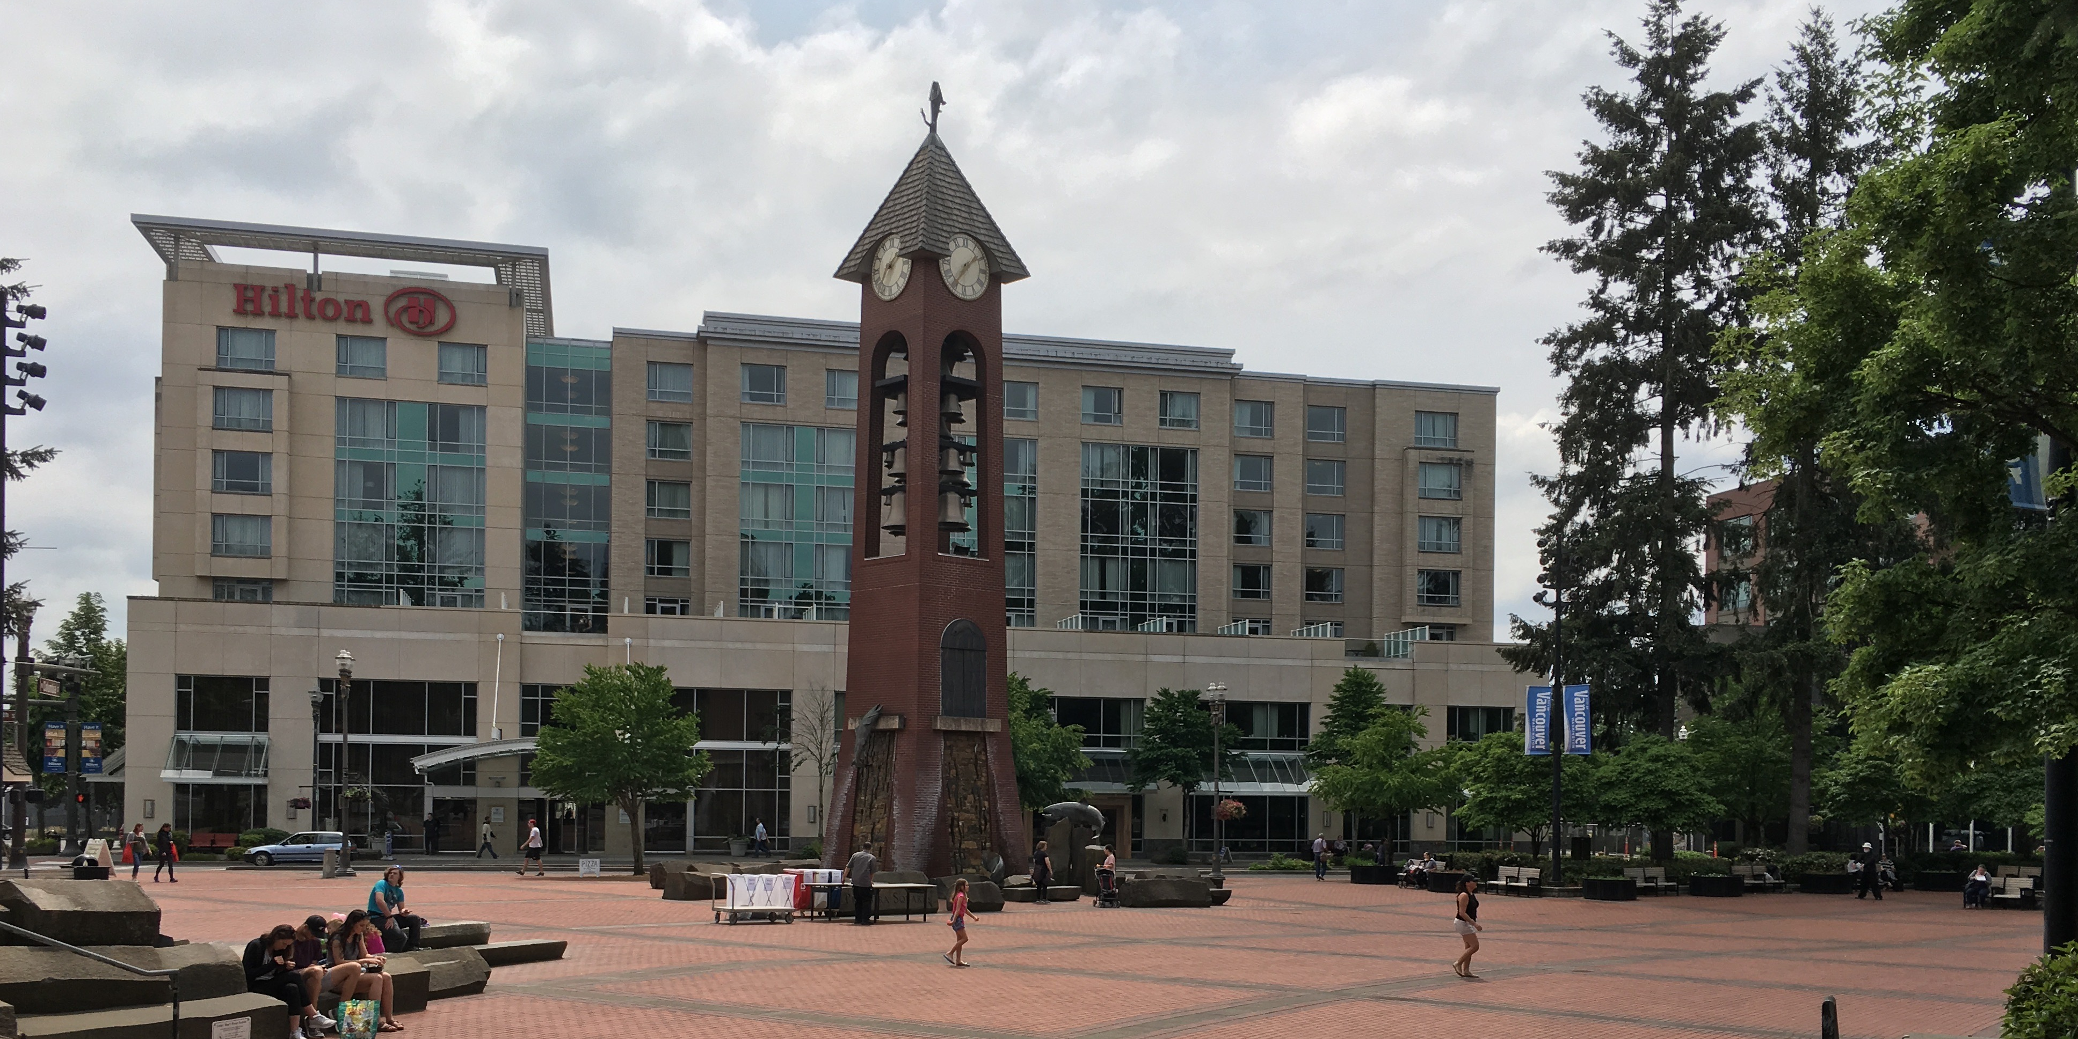
Presidents’ Report
2018 WSPTA Convention, May 18-20
Alisa George attended
  as a Voting Delegate
Highlights:
  Keynote by National PTA President-Elect Leslie Boggs
  Awards Presentation – PCMS PTSA received Silver level Standards of Excellence award!
  Recognition of our State Reflections Award of Merit winner Katherine Farr (Dance Choreography)
  Consideration of Resolutions regarding recess and physical activity, universal design for learning, and improving outcomes for foster and homeless youth

Slide 6
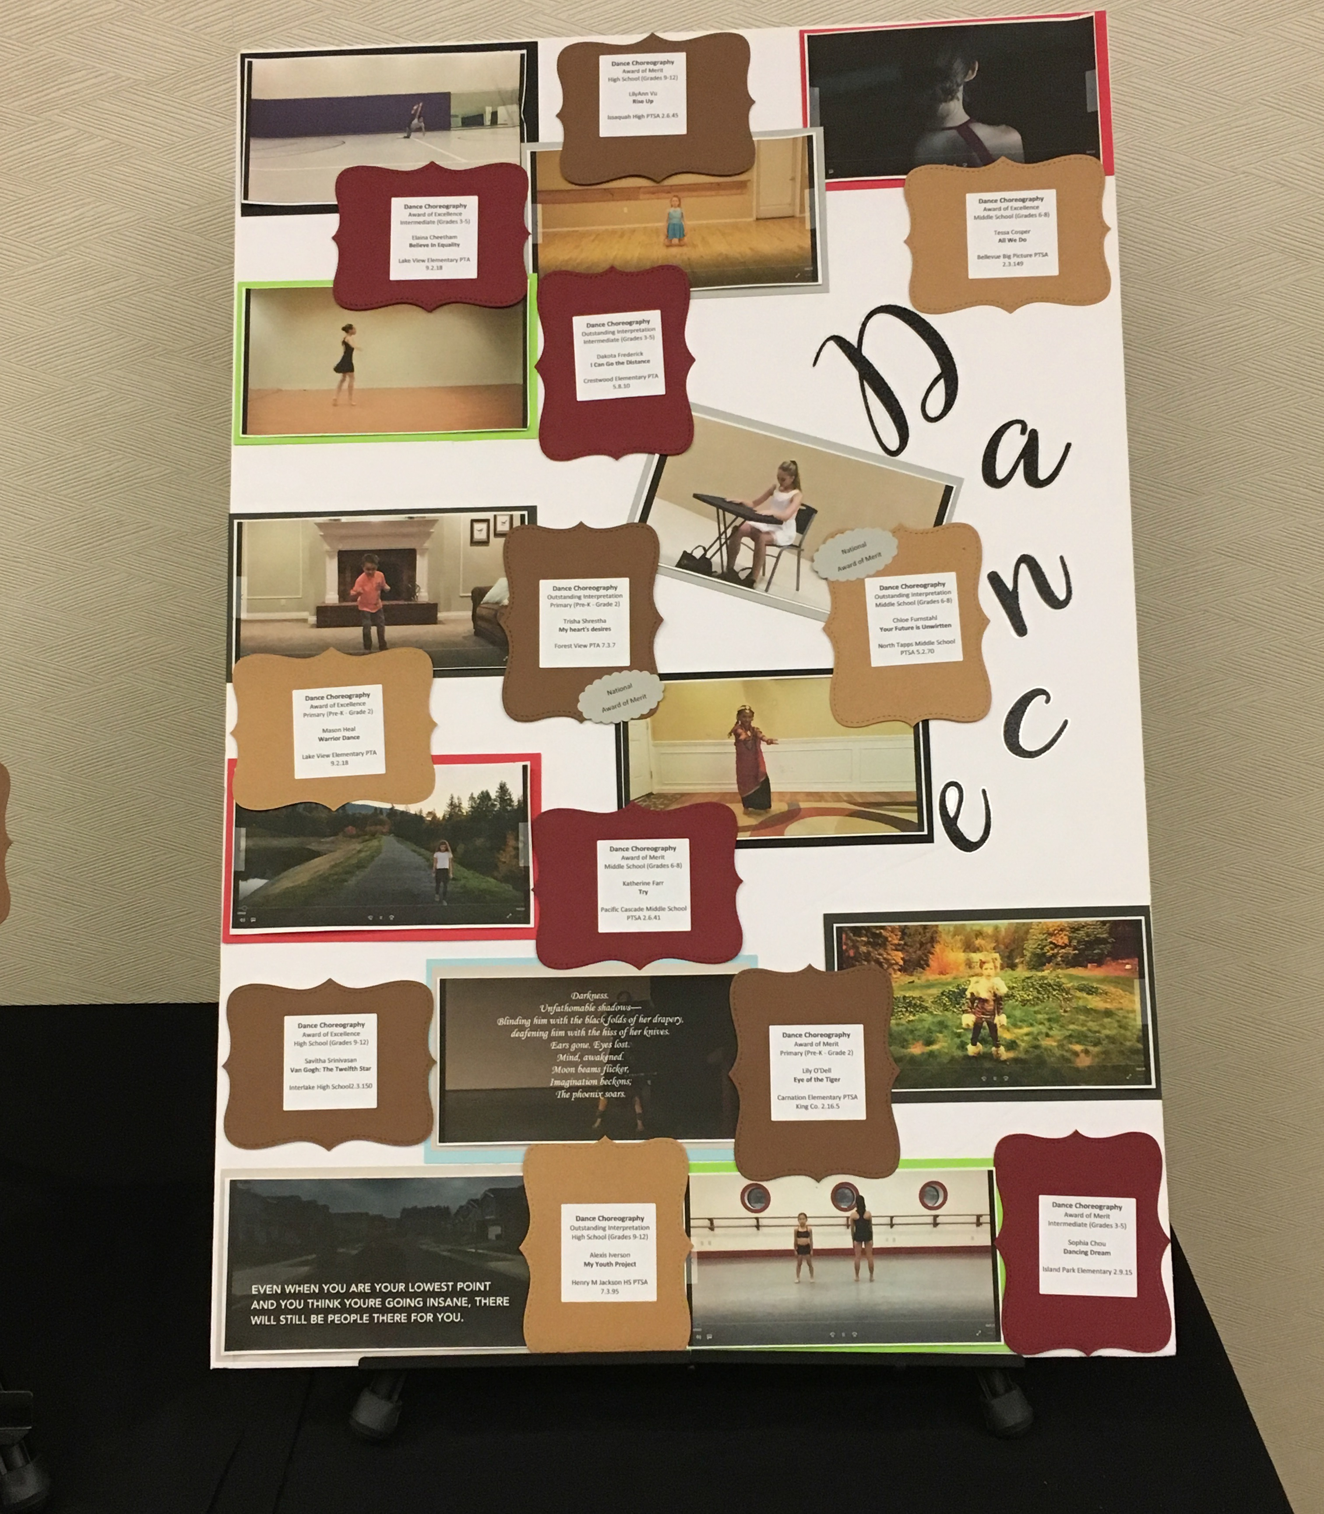
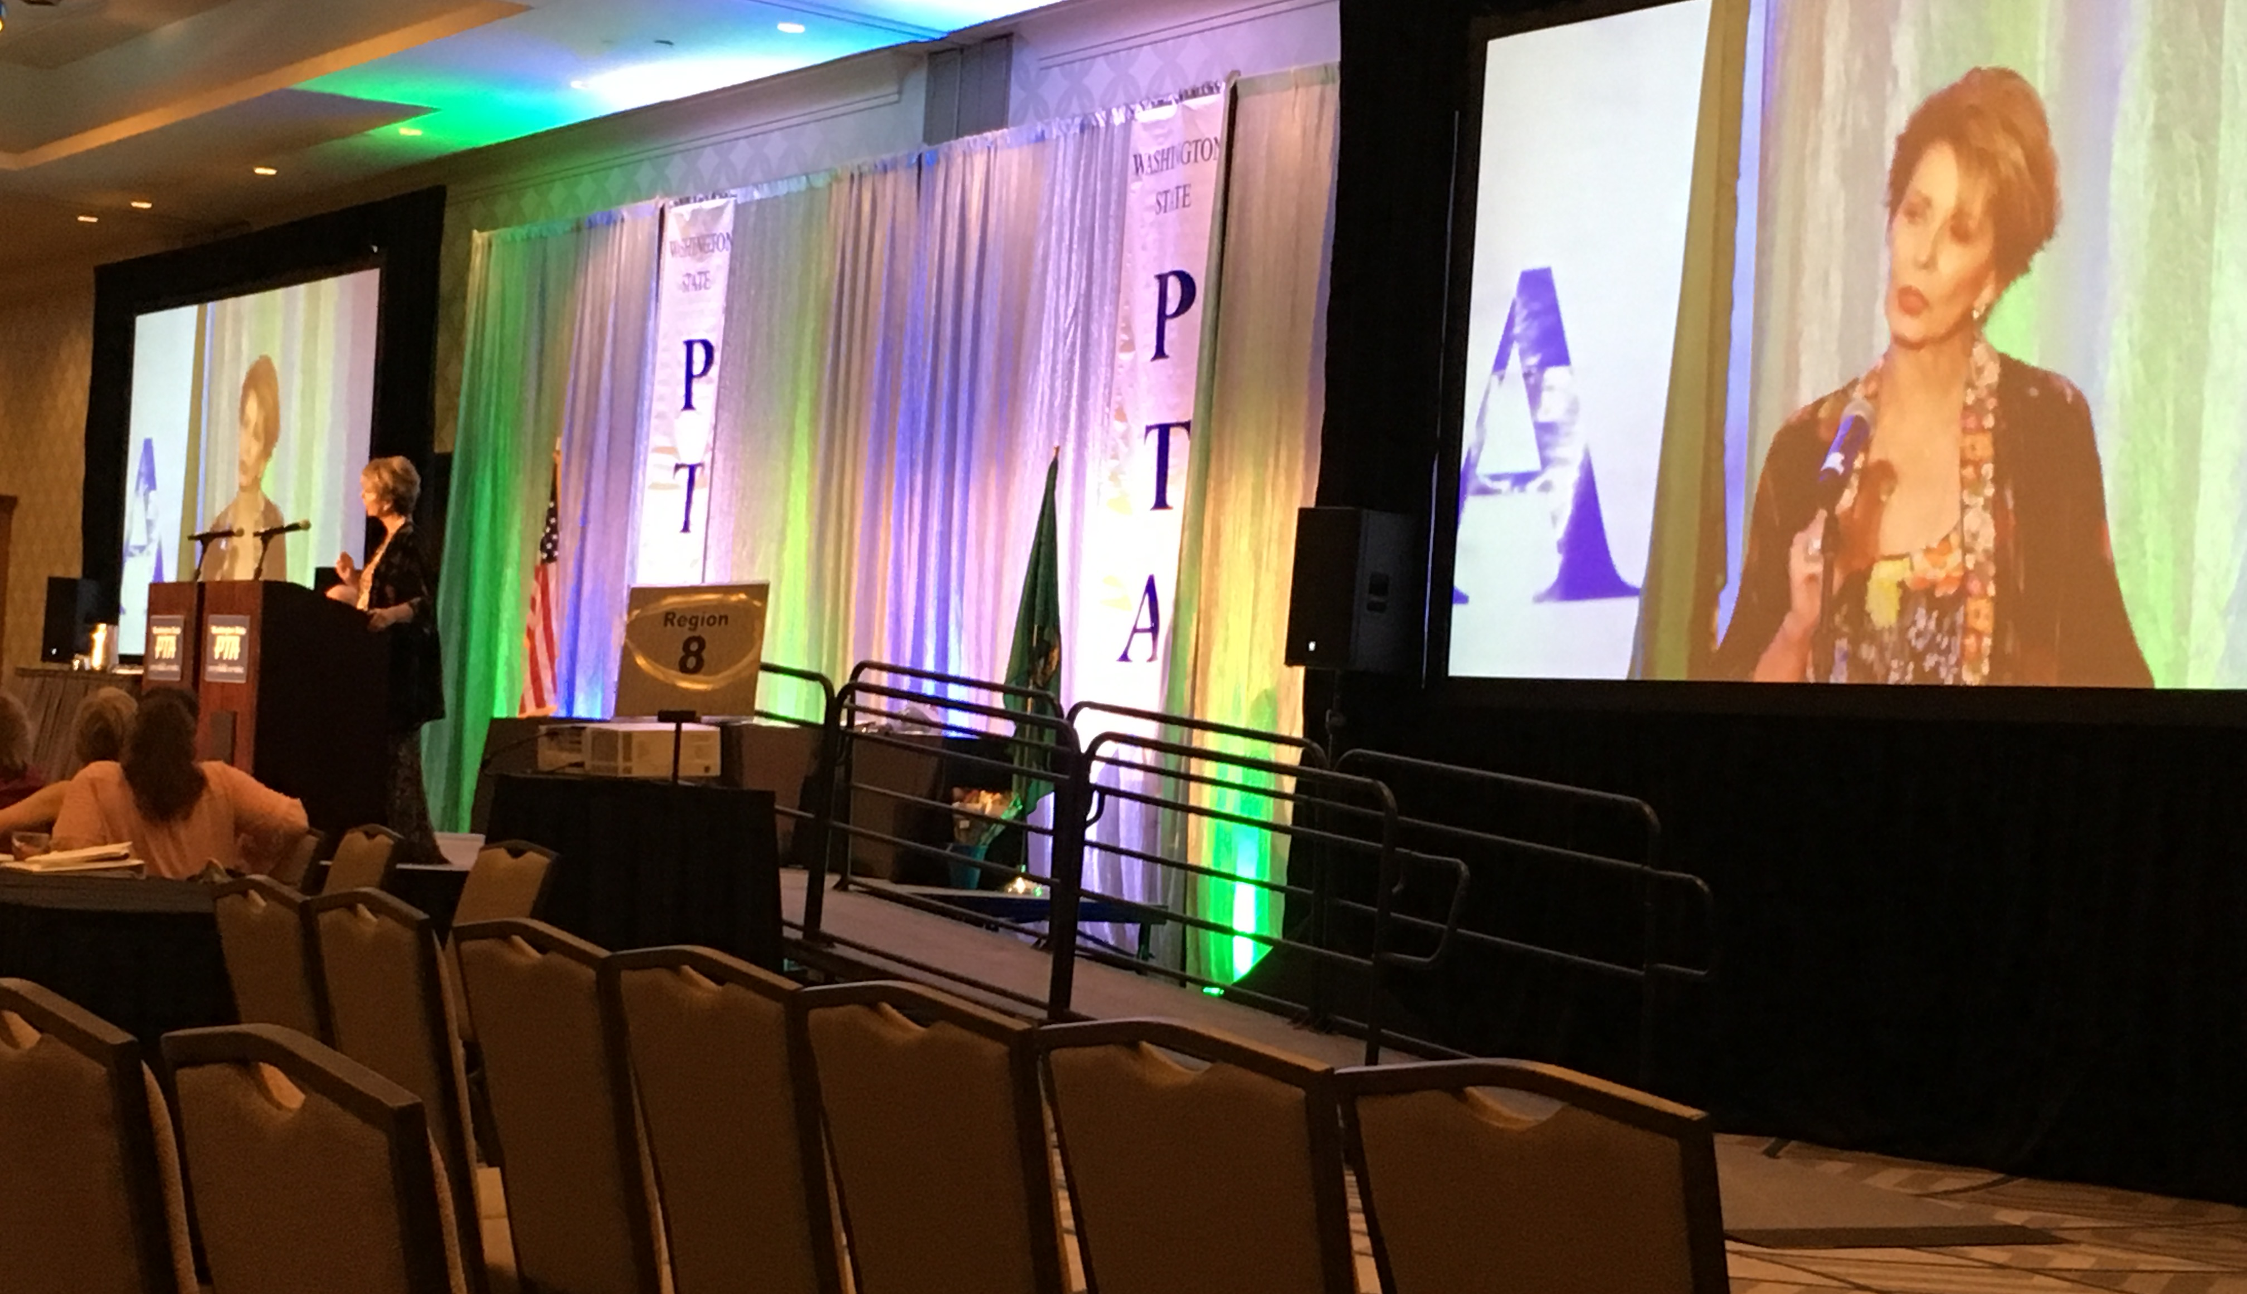
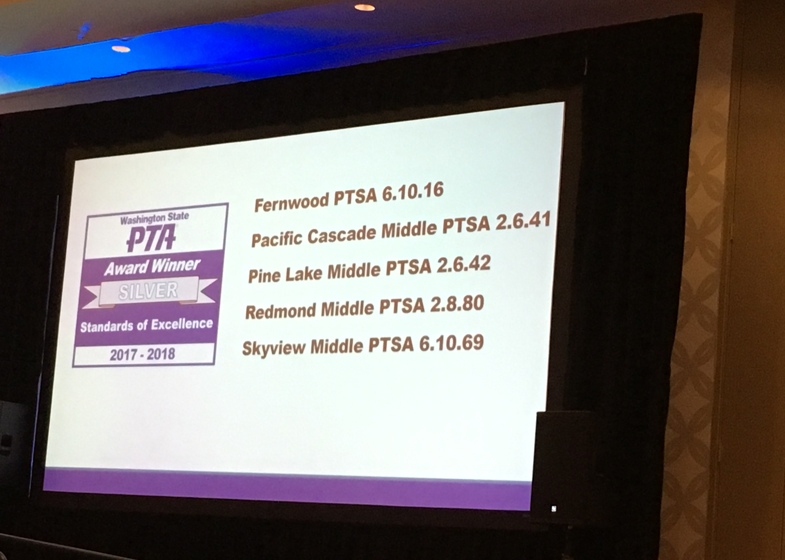
Presidents’ Report

Slide 7
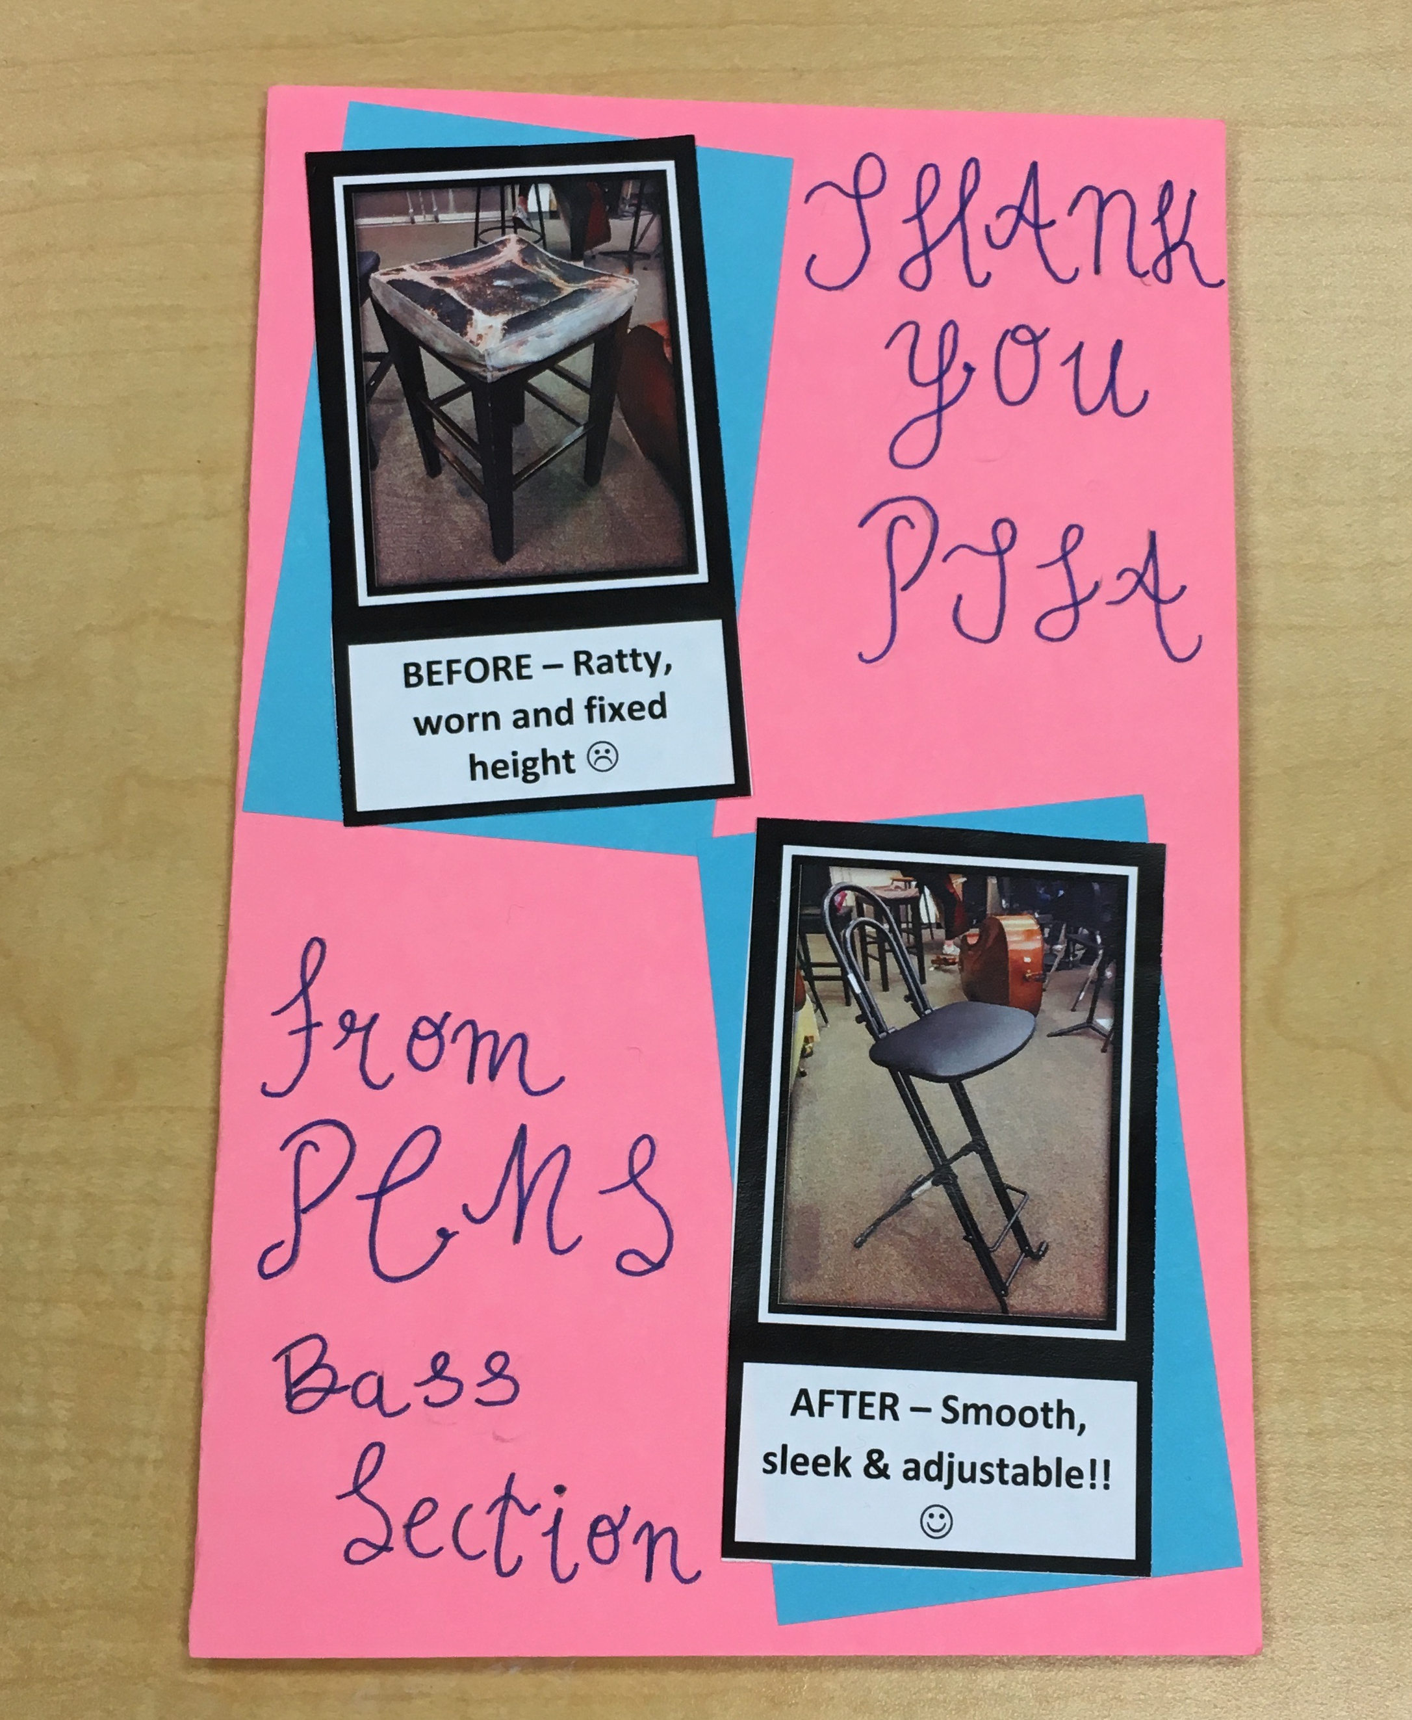
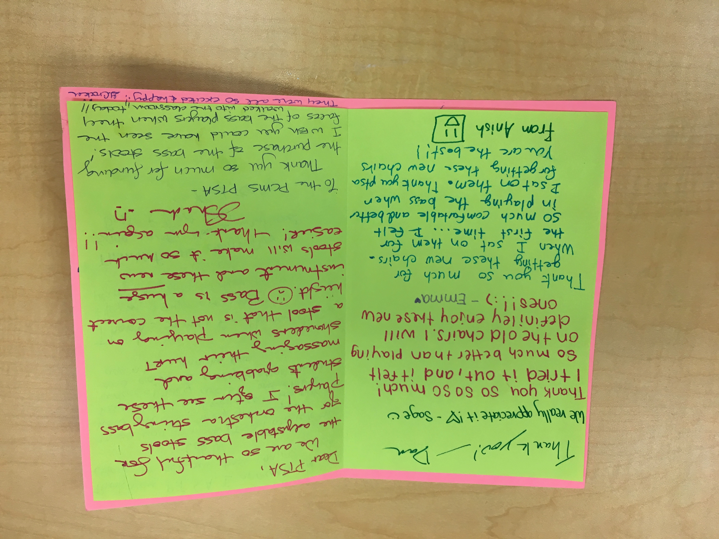
Presidents’ Report
Thank you for PTSA grant to purchase four adjustable stools for Orchestra (approved at March 15 Membership Meeting)

Slide 8
Presidents’ Report
Open PTSA Positions 2018-2019
Board |  | Chair
V.P. – Programs/Events |  | ASB Food Drive (Winter)
Director of Advocacy |  | ASB Socials (Fall & Spring)
Director of Communications |  | Career Fair (Winter)
Director of Parent Education |  | Holiday Gift Barn (Fall)
 |  | Locker Checks (End of Tris)
 |  | Lost & Found (End of Tris)
 |  | Make Up Picture Day (Fall)
 |  | Staff Appreciation Breakfasts (Monthly)
 |  | Vision & Hearing Screening (Fall)

Slide 9
Presidents’ Report
PTSA Survey - Please take our brief survey about the PTSA now until June 14 – link is on our website and in the weekly eNews. We value your opinion!
Save the Date: Tuesday, August 28. Issaquah High PTSA is hosting a New to IHS Night (for incoming 9th graders and 10-12th grade transfers). Doors open at 6:30pm; program runs from 7:00-8:00pm.

Slide 10
Treasurer’s Report
March/April Highlights:
All income and expenses as expected and within budget
Income primarily from Membership & Corporate Matching
Expenses paid include:
  Cultural Fair
  Awards (Golden Acorn, Outstanding Advocate, Outstanding Educator)
  Curriculum Enrichment Grants (approved at March Membership Meeting)
Renewed our charitable status with WA State
There have been no claims against our insurance
Beginning in July, bank signors will be Alisa George, Eloisa Tang, and Sheila Barlow
Year end Financial Review will be scheduled in July

Slide 11
Membership
Member Enrollment – CY 753 / PY 839
Membership Percentage – 77% (979 students)

Slide 12
Programs

Slide 13
ASB/Lynx Life
Staff Appreciation Week (May 7 – 11)
          Theme: “The Happiest Place on Earth”
          PTSA worked with Ms. Butson and the Leadership class to decorate and clean the staff lounge, hang posters throughout the school, and show the PCMS staff how much they are appreciated every day!
          PTSA provided breakfasts, lunches and treats to the staff during the week
          Thank you to our families for their generous donations of food and gift cards!

Slide 14
ASB/Lynx Life
2018-2019 ASB Fundraising
Guest Speaker: ASB Advisor Amy Butson

Slide 15
Volunteers
Upcoming volunteer opportunities:
8th Grade Party Chair – June 15
The 8th Grade Party will take place on June 15th from 6:30pm-8:30pm. The party will be held in the commons and the gymnasium.
We have already started to request donations for raffles, as well as volunteers to help work and chaperone the party.
We need a parent to take the lead for this fun night.
Last Day of School and Social – June 20
More info to come!
Lynx Days – August 21 & 22
We need parents to help with student photos, schedules, PE clothes, books, lockers, and much more! Please mark your calendar, and sign up to volunteer here: https://docs.google.com/spreadsheets/d/13cwYaZztVENP0pI42uJPN7dOUIOsZ65l_fVEWJAte9g/edit?usp=sharing

Slide 16

Issaquah Schools Foundation
Tools4School
You can donate a supply kit, backpack,
or both via:
  https://supplyallkids.com/#/donate/isf
Donation deadline is 7/28/18
Backpacks and supplies will be given to students who need financial assistance on August 1st and 2nd at Clark elementary.
If you know of anyone who needs assistance, they can register at: http://isfdn.org/tools-for-school-registration/ to receive a backpack with supplies.

Slide 17
New Business
Additional Enrichment Grant Requests
Approval of 2018-2019 Preliminary Budget
Preview of 2018-2019 Calendar

Slide 18
Additional Grant Requests
PCMS Staff and Dana Bailey have requested Enrichment Grants from PTSA for the following items:
Name | Item | Cost
GR 6 Science | Classroom Stools Set (30) | $4,260.00
Philip Dungey | Two Bari Sax cases | 900.00
Dana Bailey | “The Innovator’s Mindset” books for professional development book study | 1,170.96
 |  | _________
Total Requests |  | $6,330.96

Slide 19
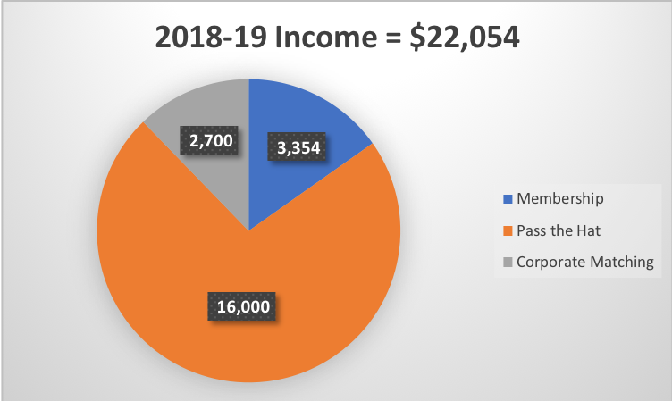
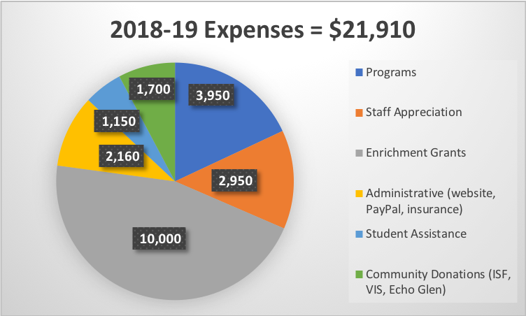
2018-19 Proposed Budget

Slide 20
2018-19 Calendar Preview
August |  | January
21-22: Lynx Days |  | 17: Membership Meeting 28: WSPTA Focus Day
September |  | February
4: Staff Appreciation Lunch 13: Fall Social 20: Membership Meeting |  | 1/29-2/4: WSPTA Advocacy Week
October |  | March
21: WSPTA Legislative Assembly 29: Reflections Entries Due |  | 21: Membership Meeting 22: Staff Appreciation Lunch
November |  | April
14: Reflections Reception 15: Membership Meeting |  | 26-28: WSPTA Convention
December |  | May
4: Holiday Gift Barn 7: Staff Appreciation Lunch |  | 6-10: Staff Appreciation Week 30: Membership Meeting

Slide 21

Parent Education
School Librarian Michael Fleming

Slide 22
Adjourned.
Thank you for coming!
See you in the Fall!!

